Slide 1
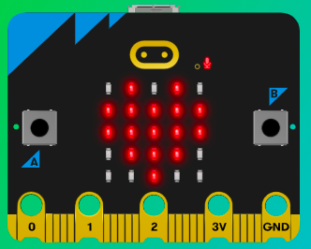
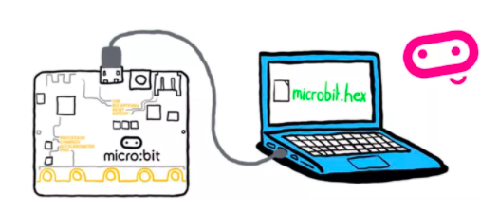
MicroMakers!
KIDS’ MAKER CLUB OF WASHINGTON, DC
Meet Up #19 - 20

Slide 2
RECAP!
Notes:
LEDs, Buttons, Light Sensor

Slide 3
RECAP!
Variable
Function
Syntax
If-Then-Else
Bugs
Bells and Whistles

Slide 4
RECAP!
Variables
For each of the following variables, tell us: (1) Its name; (2) Its value; (3) Whether the value is an integer, float, or string.
food = “bananas”
myScore = 3
name = “Robbie”
age = 12
poolBall = “8”
length = 6.5
ç

Slide 5
RECAP!
Functions
For each of the following functions, tell us (1) Its name; (2) What inputs go in between the parentheses; and (3) What it does with the inputs.
print ()
input ()
int ()

Slide 6
RECAP!
Syntax
Will the following code create a BUG or will it run (correctly)?
name = “bananas”
food = bananas
score = “3”
My score = 3
luv2Sail = “yes”
print (“I love cream cheese.”)
print (“I love eggs, too.”) (“and ham.”)
Print (But broccoli is the best.)
print (“Sue’s favorite food is {food}.”)
food = input (“What is your favorite food?”)
print f(“Breakfast rocks, especially {food}.”)

Slide 7
RECAP!
Operators
Python already knows how to do basic math. What do these operators do?
+
-
/
*
**

Slide 8
RECAP!
Operators: What will these lines of code do?
print (3*6)
print (3**2)
print (”The answer is (4+5).”)
print (”The answer is {4+5}.”)
print (f”The answer is {4+5}.”)

Slide 9
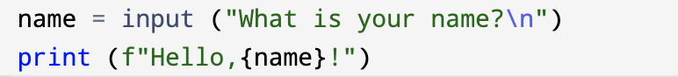
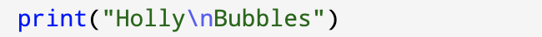
RECAP!
Code Reading

Slide 10
RECAP!
Code Reading
a = int(input(“Enter a number between 1 and 100:\n”))
b = int(input(“Enter another number between 1 and 100:\n”))
print (f”When I add them together, I get:{a+b}”)

Slide 11

PYTHON

Slide 12
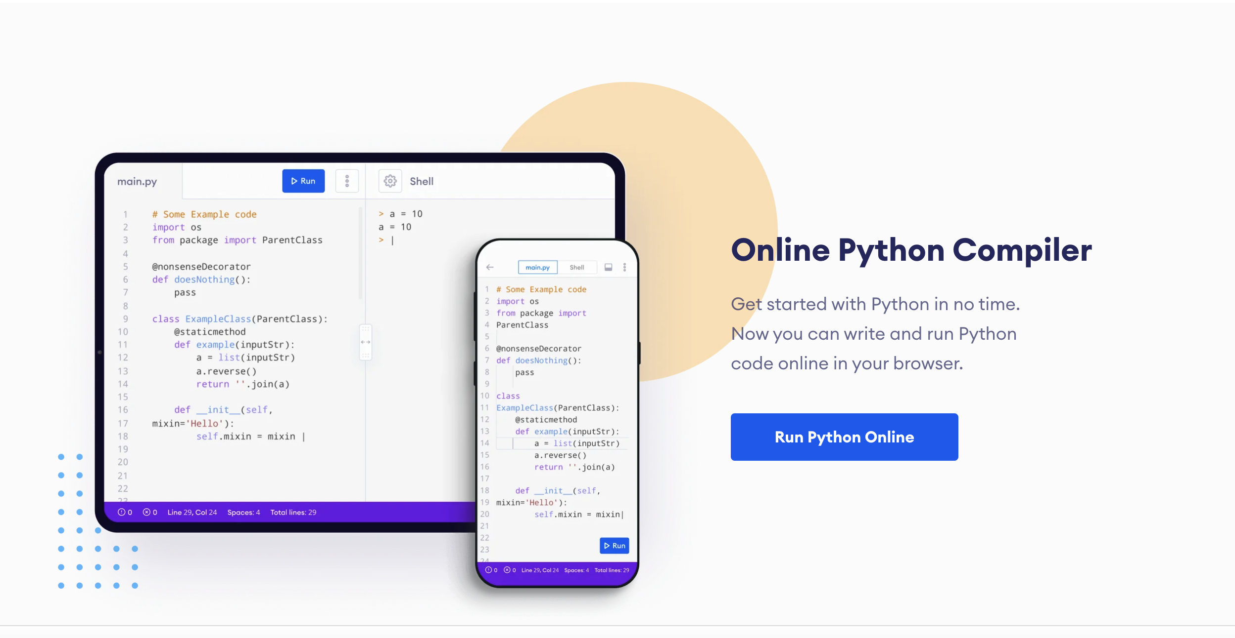
Let’s Get Started
Using an online code editor and compiler
Go to: https://www.programiz.com
Find and click this button:

Slide 13
CODE WARMUP
Practice Makes Perfect
Make an app that creates a new band name!
Print the name of your app (e.g., print (“**Band Name Maker**\n”)
Create a variable called “city” and ask user to input their favorite city.
Create a variable called “pet” and ask user to input their favorite pet.
Combine the variables to create a new band name, using print (f””).

Slide 14
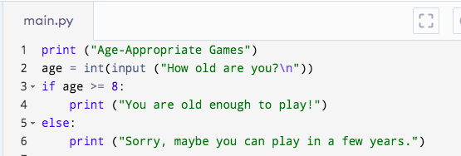
IF-THEN-ELSE
Read this Code!

Slide 15
SYNTAX
If-Then-Else
If <something is true>:
<do this>
Else:
<do that>
If <something is true>:
<do this>
Elif <something else is true>:
<do this>
Else:
<do that>

Slide 16
SYNTAX
If-Then-Else
<something is true>
name == “Holly”
age >= 10
color != “blue”
length == 7.5

Slide 17
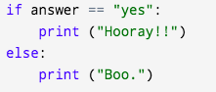
PRACTICE
Coding!
Write a program that responds to a yes or no question:
Create a variable called answer. Ask user to input the value by asking a yes or no question, like:
Write an if-else statement, with a different response based on the answer, like:

Slide 18
Step 1: The Project
Choose your Own Adventure!
What is it?
Create an interactive story, where the player chooses their own adventure!
What do I need?
A code editor, Python, and a compiler (online or installed on your computer).

Slide 19
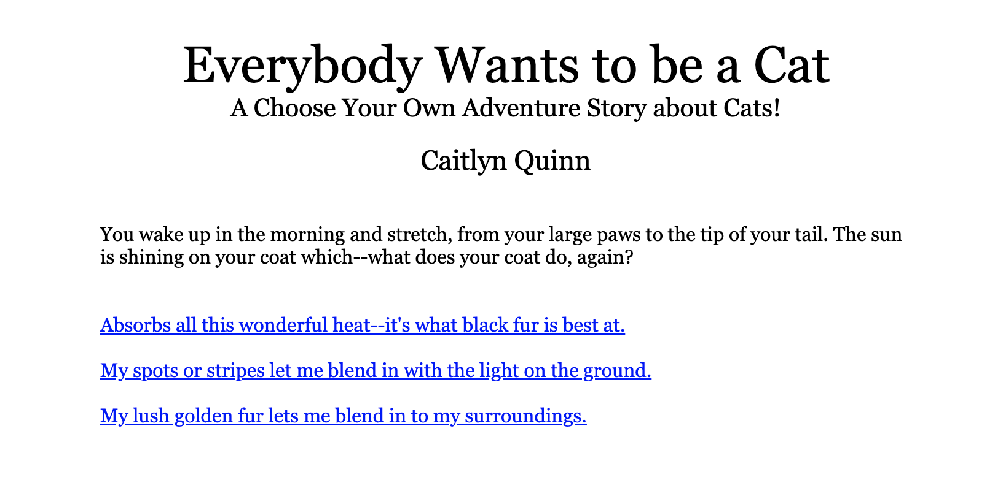
Step 2: How Does it Work?
https://bit.ly/3vT6LbR
Let’s Try a Text Adventure Game

Slide 20
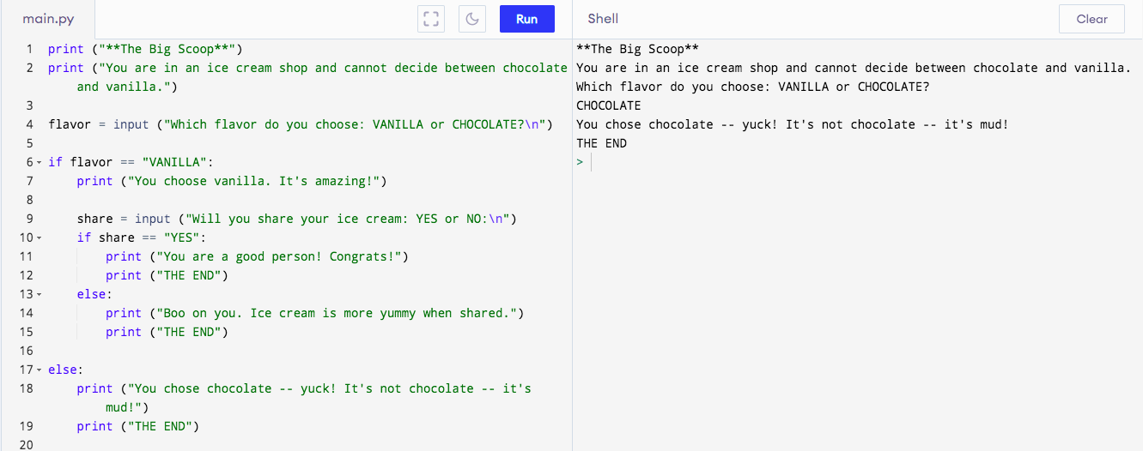
Step 2: How Does it Work?

Slide 21
Step 2: How Does it Work?

Slide 22
Step 2: How Does it Work?

Slide 23
Step 2: How Does it Work?
Steps
Create a decision tree with: story title, opening narrative, and decisions. Keep it super short and simple for this first attempt! You can always add later.
Code it!
Debug it!

Slide 24
Step 3: Code It
Your first coding building blocks
No hints here – you’ll have to rely on your notes!

Slide 25
Step 4: Share Your Creation!

Slide 26
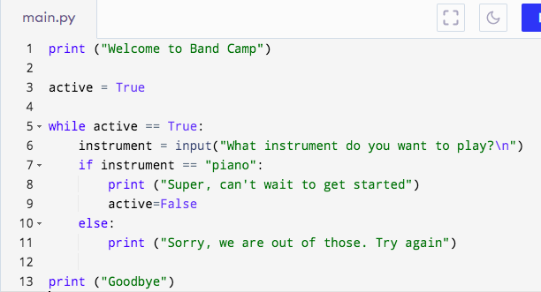
Programs to Try at Home
Welcome to Band Camp

Slide 27
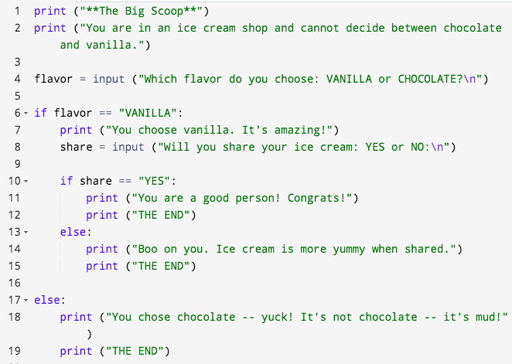
Programs to Try at Home
The Big Scoop

Slide 28
TIME TO PUT AWAY OUR COMPUTERS!
Neat and tidy, please!
Let’s leave this beautiful room as lovely as we found it!

Slide 29

UNTIL NEXT TIME….
MicroMakers!
Slides and Script: Holly Krambeck (learningpython64@gmail.com)

